Slide 1


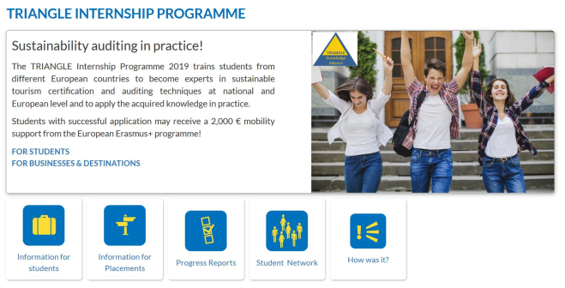

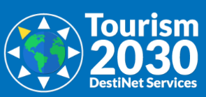


Multi-stakeholder collaboration for transformative tourism education in sustainable development: The case of TRIANGLE
Dagmar Lund-Durlacher *, Ulrich Gunter *, and Gordon Sillence °
* MODUL University Vienna, ° Ecotrans
Background
Example: Modul University Vienna
Achieving sustainable development is a continuous process of learning (UNESCO, 2002) and therefore innovative teaching strategies and specific pedagogical tools are needed to teach sustainable tourism.
Pedagogical approaches to support education for sustainable development (Tilbury, 2011):
Processes of collaboration and (intercultural) dialogues among multi-stakeholders.
Teaching and learning experiences of active and participatory learning, which encourage learners to ask critical and reflective questions, clarify values, envision more positive futures, think systemically, respond through applied learning, and explore the dialectic between tradition and innovation.
Case studies, which enable students to investigate local issues and to collaborate with local stakeholders, serve as catalysts for developing students’ critical thinking skills, and can help to influence students’ emotions towards a more sustainable development (Lund-Durlacher, 2015).
MSc in International Tourism Management – Specialization area ‘CSR Management’
The specialization “CSR Management” comprises a total workload of 18 ECTS points, which is allocated to the following required and optional courses:
Competence in sustainable travel and tourism certification online course (overview of certification in tourism) including training on the Tourism 2030 knowledge base platform resources (2 ECTS points, required).
An auditor training at a sustainable tourism certification scheme (such as the Austrian Eco Label, Green Destinations, TourCert, etc.) (1 ECTS point, required).
A qualified internship (340 hours / 2 months) at a cooperation partner (6 ECTS points, required).
A combination of several of the following modules from the sustainable development of tourism online course (9 ECTS in total required). (Table 1)
TRIANGLE - Tourism Research Innovation And Next Generation Learning Experience
Objectives:
Developing a sustainable tourism training system which offers collaborative, intercultural and participatory learning experiences in a multi-stakeholder setting.
Linking research and higher education bodies to tourism businesses and organizations by creating a common knowledge development and training process.
Project partners:
A consortium composed of
Leading European universities (Eberswalde University for Sustainable Development (Germany), Modul University Vienna (Austria), University Paris Panthéon-Sorbonne (France) and University of Algarve (Portugal))
the ECOTRANS Network for Sustainable Tourism
Forum Anders Reisen (an association of German tour operators and their businesses partners around Europe)
Eau de Web (a Romanian IT-specialist).
Figure 2: The TRIANGLE Internship Programme. Source: Tourism 2030 DestiNet Services.
 | Name of module | Working hours | ECTS points
Module 0 | Foundations of Sustainable Tourism | 50 | 2
Module 1 | Climate Change & Energy Resource Efficiency | 25 | 1
Module 2 | Natural Heritage & Biodiversity | 25 | 1
Module 3 | Travel, Transport & Mobility | 25 | 1
Module 4 | Human Rights & Labor Rights | 25 | 1
Module 5 | Value Chain Management & Fair Trade | 25 | 1
Module 6 | Cultural Heritage, Lifestyles & Diversity | 25 | 1
Module 7 | Good Governance & CSR | 25 | 1
Module 8 | Marketing & Certification | 25 | 1
Module 9 | Destination Management | 25 | 1
Module 10 | Knowledge Networking, Training & Education | 25 | 1
Total |  | 300 | 12
The TRIANGLE Training System (Start in November 2018)
Target Group: Master students enrolled in tourism programmes from different European countries, as well as professionals working in tourism destinations or the tourism industry.
Learning outcomes:
To understand tourism sustainability challenges and opportunities along the 17 Sustainable Developments Goals (SDGs).
To be an expert in sustainable tourism development and in sustainable tourism certification and auditing techniques at national and European levels.
Training Elements:
Two interactive European graduate online courses supported by a tourism sustainable development open educational resource kit (“Going Green Business Programme”, “Green Mapping System”, “Certification Quick Finder”, and “Best Practice Browser”).
An in-situ or online training in one of the partnering certification schemes.
A placement and internship system for students linked to the knowledge base and the training system.
Table 1: Overview of the modules from the online course “Sustainable Development of Tourism” including allocated working hours and ECTS points. Source: authors’ own visualization.
Conclusions
Learning for sustainable tourism development is not only a “process of gaining knowledge, values and theories related to sustainable tourism but it also calls for a changing of mindsets and active engagement of the student in matters relating to more sustainable tourism futures” (Tilbury, 2011, p. 23).
Current curricula and learning environments provided by HEIs generally do not implement this transformative approach toward education.
Online course
Recommendations
Learning for sustainable tourism requires a more holistic approach in education for sustainable development.
It is not only a matter of introducing the concept of sustainable tourism into the curriculum, but also of using teaching approaches which enable social learning towards a sustainable tourism future beyond the mere creation of a body of knowledge (Lund-Durlacher, 2016).
The engagement in practical sustainability activities in a multi-stakeholder environment contributes to changing the students’ behavior and changing their mindsets.
Certification training
Internship
Figure 1: The TRIANGLE Knowledge Alliance. Source: https://destinet.eu/who-who/civil-society-ngos/triangle-knowledge-alliance-net/ , and authors’ own visualization.
Selected References
European Commission (2019): European Credit Transfer and Accumulation System (ECTS). Retrieved from https://ec.europa.eu/education/resources-and-tools/european-credit-transfer-and-accumulation-system-ects_en
Gunter, U., Zekan, B. (2019): The Power of Knowledge Alliances in Sustainable Tourism: The Case of TRIANGLE. In: Lund-Durlacher, D., Dinica, V., Reiser, D., Fifka, M. S. (eds.) Corporate Sustainability and Responsibility in Tourism. Series: CSR, Sustainability, Ethics & Governance. Springer: Heidelberg, forthcoming.
Lund-Durlacher, D. (2015): Sustainable Tourism Education: An Institutional Approach. In Moscardo, G., Benckendorff, P. (eds.) Education for Sustainability in Tourism: A Handbook of Processes, Resources, and Strategies. Berlin, Springer: Berlin, 93-100.
Lund-Durlacher, D. (2016): Transformative Tourism Education: The Holistic Approach at MODUL University. Madrid: World Tourism Organization (UNWTO), 80-83.
Tilbury, D. (2011): Education for Sustainable Development: An Expert Review of Processes and Learning. Paris: UNESCO. Retrieved from https://unesdoc.unesco.org/ark:/48223/pf0000191442
UNESCO (2002): Education for Sustainability, From Rio to Johannesburg: Lessons learnt from a Decade of Commitment. Paris: UNESCO. Retrieved from http://unesdoc.unesco.org/images/0012/001271/127100e.pdf
Accreditation:
The programme applies the European Credit Transfer and Accumulation System (ECTS), a credit system based on the learning achievements and workload of a course. The workload is measured by ECTS points, whereby 1 ECTS point translates into 25 hours workload for the student (European Commission, 2019).
Implementation of TRIANGLE into existing graduate curricula:
The TRIANGLE training system is set up in a modular way and universities can implement the training elements and modules to fit into existing curricula. They can be stand-alone courses or combined with existing courses.
Collaborative workflow among universities:
A collaborative work-flow system with trained administration teams from each university guarantees the continuous development of the knowledge base and the online course.
The online collaborative “TRIANGLE Training Education and Development Space” provides common access to documents, web tools, and course content workflow systems.

