Slide 1
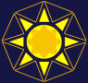
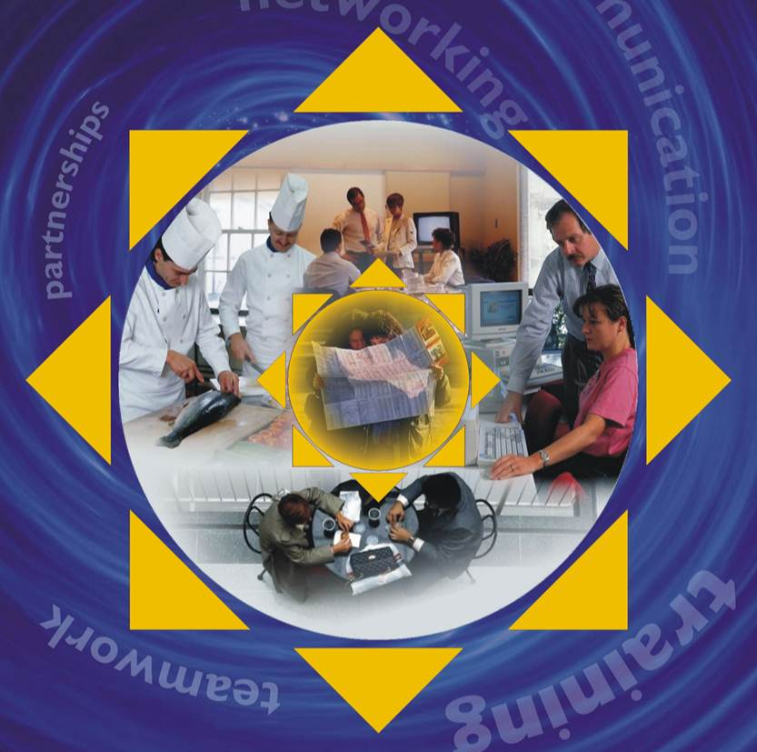



Tourism
Knowledge & Innovation
Communities
A Guide to Multi-Stakeholder Tourism Knowledge Networking to Improve European Innovation, Competitiveness and Sustainability
Further Action on Sustainable Tourism –
Learning Area Innovation Networks
(FAST-LAIN)
EU Project – CIP Programme DG Enterprise 2011- 2012

Slide 2

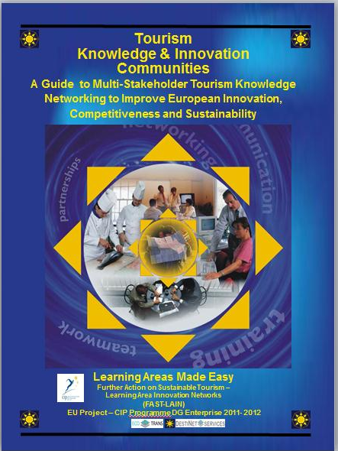
Tourism Knowledge and Innovation Communities
- A Guide to Multi-Stakeholder Tourism Knowledge Networking to Improve
European Innovation, Competitiveness and Sustainability
European Commission DG Enterprise CIP
FAST-LAIN Project 2012
Produced by: Gordon Sillence, Herbert Hamele
Ecotrans -DestiNet Training, Education & Development Services
with the FAST-LAIN team
A copy of this document can be found at
http://destinet.eu/resources/...-various-target-groups/tourism-learning-area-toolkit
DOCUMENT VERSION: FINAL
Nov 2012

Slide 3
Contents
Executive Summary ……………………………………….………………………………... 4
PART I Theory .............................................................................................. 7
1. What are Tourism Knowledge and Innovation Communities? ………………….. 8
2. Building a Tourism Knowledge and Innovation Community Model ............. 21
  PART II Practice ………………………………………………………………………………..... 28
  Setting up a Topic Knowledge and Innovation Community ………………….…. 30
  Setting up a Destination Knowledge and Innovation Community ………….…. 35
  Stakeholder Mapping Tool ……………………………………………………….…. 37
  Sustainable Tourism Topic Framework Tool …………………………….….. 39
  Resource Listing Tool ……………………………………………………………….…. 40
  Good Practice Transfer Tool……………………………………………………….… 41
  Market Access Tool ………………………………………………………………….…. 42
  Tourism Observatory Management Tool …………………………………….. 44
  Market Innovation Stimulation Tool ………………………………………..... 45
  Part III Next Steps
  Costs …………………………………………………………………………………………………… 50
  Conclusion …………………………………………………………………………………………… 51
  Check List …………………………………………………………………………………………….. 52

Slide 4
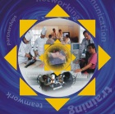
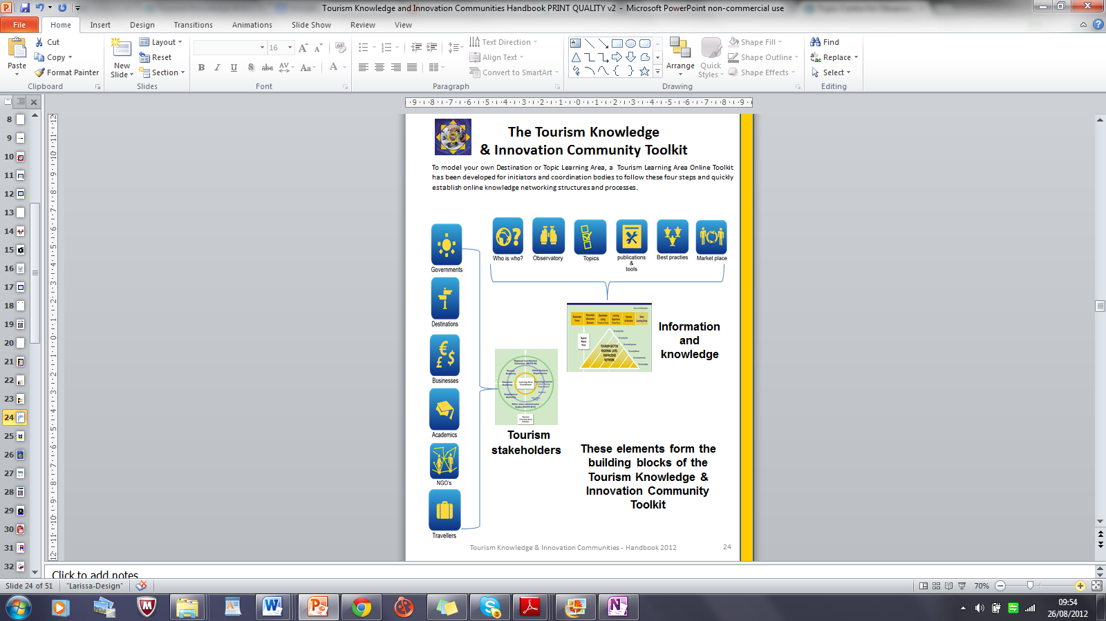
Executive Summary - Tourism Knowledge & Innovation Communities (Tourism KICs)
WHY? Tourism Knowledge and Innovation Communities - A Guide to Multi-Stakeholder Tourism Knowledge Networking to Improve European Innovation, Competitiveness and Sustainability has been developed in the European Commission DG Enterprise CIP FAST-LAIN Project 2012. The call for improved sustainability, competitiveness, & inclusiveness through innovation means delivering new marketable tourism products and business infrastructure support services, but this requires more flexible, knowledgeable, qualified labour, improved access to knowledge and structured good practice transfer systems in which research feeds back into policy making and market actions for all sectors, including tourism.
WHAT? European-level knowledge networking actions can help improve SME and regional success in the European and global market places. The concept of Tourism Knowledge & Innovation Communities (Tourism KICs) synthesizes the Commissions’ 2006 Tourism Learning Area approach and the 2012 European Research Areas’ Knowledge & Innovation Communities concept, both of which have knowledge transfer and innovation development through multi-stakeholder interaction at their heart. Tourism KICs are built by online mapping, networking and clustering of academic, business and administrative stakeholders in a systematic European-wide knowledge transfer and support process, focused on improving workforce, SME and regional competitiveness.
WHO? The Tourism KIC approach focuses on using ICT to network tourism stakeholders in a structured way. Communities are designed to link learning to innovation by putting administrators, businesses and the work force in the flow of market relevant information. They allow stakeholders to move ‘From Knowledge to Product, From Research to Market place’ by improving links between learning experience providers and their clients. This research to market innovation cycle involves the following knowledge & product development process:
  RESEARCH > POLICY > PRODUCT/DESTINATION DEVELOPMENT >
        PROMOTION > MONITORING>
HOW? Knowledge & Innovation Communities are based on collaborative (multi-stakeholder) use of common ICT platforms. A common ICT portal coordinates access to learning opportunities to improve administrative coherence, work-force training, SME competitiveness and regional sustainability. A Topic Information Framework and Subject Index has been defined to organise Tourism Knowledge & Innovation Communities, with a 4 step implementation plan . The DestiNet Tourism KIC Toolkit has been developed for professional use by initiators and coordination bodies to quickly establish online tourism knowledge networking structures and processes. This handbook will take you though the basics of using the DestiNet Portal for Sustainable & Responsible Tourism as an online tool to set up a Knowledge & Innovaton Community. Also see the section on costing a Tourism KIC , which shows you how to tailor activities to your budget.

Slide 5





Tourism Knowledge and Innovation Communities – 7 FAST-LAIN Examples
These seven pilot areas in the FAST-LAIN Project demonstrate how
the Tourism KIC approach can be used in very different situations.
Spain: Consorcio Insular de la Reserva Mundial de la Biosfera La Palma: The Tourism La Palma Cluster
Using the FAST-LAIN ‘from research to market place’ approach, La Palma has:
◊ brought together many stakeholders and businesses from its 14 municipalities, and a
comprehensive listing of information sources,
publications, tools and events…
◊ set up the La Palma Club as self committed platform for knowledge networking and exchange on the island and with stakeholders and other Spanish biosphere reserves that are part of the “Biosphere Reserves Tourist product Club”,
◊ identified good practice examples and mapped
them on the DestiNet market place.
La Palma now will continue and further strengthen their initiative and innovation processes through using DestiNet for local to global knowledge exchange, networking and collaboration for making tourism more competitive and sustainable.
Portugal: Universidade do Algarve - Algarve Nature Tourism Network
The Algarve Nature Tourism Network initiative is developing a knowledge network for public institutions and private companies to overcome challenges and seize opportunities in nature tourism through experience and information exchange. The dynamics expected for this cluster also include a greater awareness of the opportunities arising from cooperation and collaboration between actors. The Algarve International Bird Festival showcases the research to market place process in nature tourism development.
developing carbon neutral
travel packages in Saarland based on market research. The aim is to offer existing modules and combine them meaningfully with climate neutral travel offers. Using the DestiNet knowledge base, the
criteria and a checklist for the development of these offers are being developed. The first climate neutral travel deals were available for interested guests from autumn 2012.
Croatia: The Croatian Government Portal on Sustainable Tourism
This National portal provides an entry point to all interested stakeholders on laws , regulations, awards, certificates, best practices, knowledge, events, existing resources, and also on projects aimed at sustainable tourism development, including information on available national and international sources of financing. It will additionally provide a direct access to DestiNet to post the most important pieces of global and European information for Croatian stakeholders involved in the project.
Germany: Tourismus Zentrale Saarland Germany: Carbon Neutral Travel Packages
TZS is the regional tourism authority of Saarland dealing with destination marketing and management. They started the process of

Slide 6
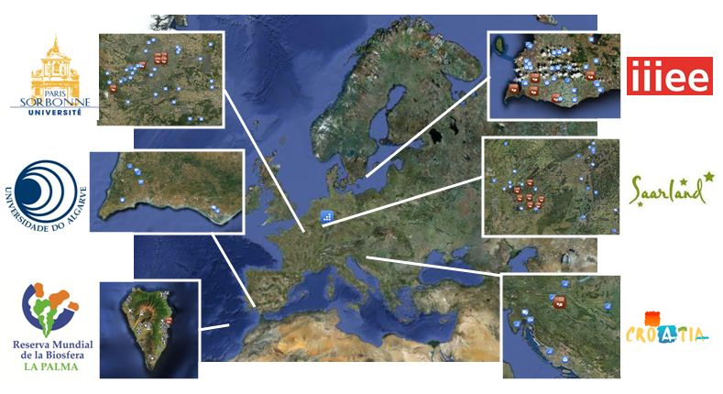


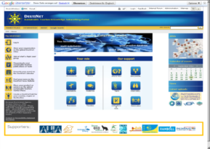
France: Sorbonne Université – IREST:
Green Map Cluster Paris
University Sorbonne in Paris France is setting up the cluster “Entrez c’est tout vert”, which aims to create an internet platform on sustainable initiatives in the region of Paris, focused on two main target groups: professionals of the tourism industry, and researchers/specialists. IREST Green Map Paris will identify the good practices of Paris stakeholders
creating a “green” thematic knowledge framework in order to establish a regional research-to-market place process in France.
Sweden: Lunds Universitet – IIIEE: Photo Tourism Cluster in Söderslätt
Lund University, Sweden, is using Söderslätt as a case study area, implementing different means of sustainable tourism development. Photo tourism is an innovative ”edutainment” concept for promotion of nature & cultural tourism for sustainable growth and increased competitiveness within European tourism. A Söderslätt cluster on the Portal has been created to increase local interaction and collaboration to deliver the photo-tourism product. The project is also forming a European network of Photo Tourism Destinations to market the concept and offers.
Norway: UNEP/GRID-Arendal - Linking Tourism & Conservation (LT&C)
GRID-Arendal are steering the LT&C Cluster initiative to create a database of incentives for positive change in tourism to benefit successful development and management of the world’s protected areas. As partner of the FAST-LAIN project GRID-Arendal hosted a LT&C seminar at the GPST meeting in Korea 2012 and conducted a survey about existing LT&C cases. The results were used to map best practice European LT&C examples on DestiNet.
You can see these clusters in detail on the DestiNet Portal

Slide 7
PART I Theory
Section 1
Background and Benefits of Tourism KICs
What are Tourism Knowledge and Innovation Communities? This section explains what a Tourism Knowledge and Innovation Community is, and why we need them for sustainable, responsible, inclusive and competitive tourism enterprise and destination development.

Slide 8
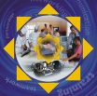
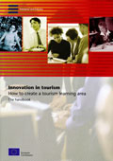
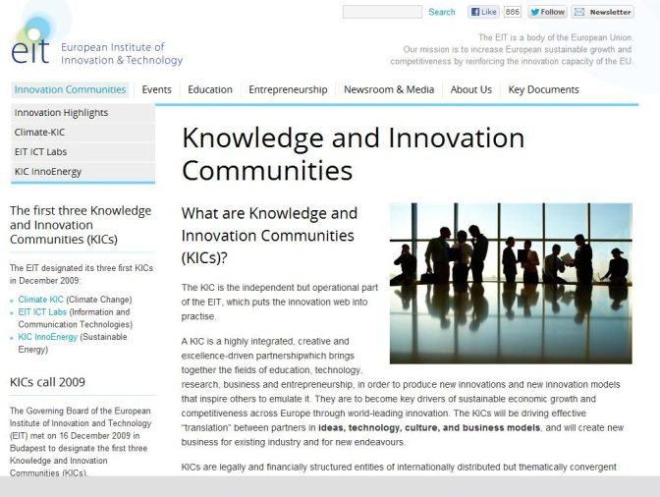
What Are Tourism Knowledge and Innovation Communities?
The Tourism Learning Area methodology was an approach developed by the European Commission to systematically network relevant stakeholders for the purpose of improving learning opportunities and maximising resource use to support enterprise and workforce development. More recently, the establishment of the European Research Area and the work of the European Institute for Innovation and Technology has given rise to the development of Knowledge and Innovation Communities (KICs), again seeking to link academic, business and administrative European stakeholders to address topical issues through research to innovation process development.
The concept of Tourism KICs brings the two approaches together at the European level. Tourism Knowledge & Innovation Communities are built by online mapping, networking and clustering (the networking of networks territorially or thematically) of academic, business and administrative stakeholders in a systematic European-wide knowledge transfer and support process.
This process is focused on improving SME and workforce competitiveness, and is designed to enable workers, companies and regions to see a European and global picture, learn more, get more connections, share knowledge and ideas, build creative teams, innovate, and have better access to support, raise finance, plan production and services, engage in markets and develop responsible & sustainable activities .
This technical manual was developed in 2006 by DG Enterprise, showing Learning Area theory and its pilot application. The Climate KIC site shown below is an example of European Research Area approach that brings the Learning Areas approach up to date.

Slide 9
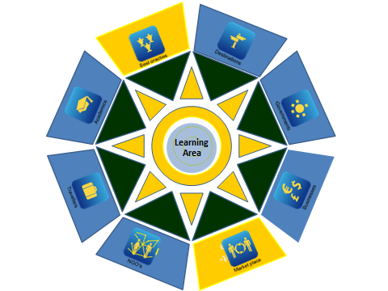
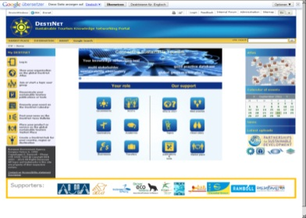
Understanding the Concept
The original learning area concept provides the rational for the modern Tourism KIC. In the DG Enterprise: Innovation in Tourism Handbook it says:
‘By raising the profile and status of learning activities, a Learning Area develops a dynamic synergy between the individual, the company and the territory … An example of this synergy is the continual work of many municipalities and regions to improve local living conditions, to attract skilled workers to live in an area, to create a human resource base, to attract companies, to improve regional competitiveness. Such synergy is a key for developing innovation. Recently it has become common practice for destinations to establish joint marketing of a comprehensive range of products and services within a destination package. In the new economy destinations need to address the issue of learning in the same manner. This can be done by identifying common needs and opportunities, grouping together the relevant stakeholders, and providing common regional infrastructure to meet stakeholders’ learning as opposed to marketing requirements. In this respect the positive experiences of Metropolitan areas and innovative regions can be used by tourism destinations to ensure healthy regional economies. The clustering of products and services in the regional supply chain is seen as one of the key goals of a Tourism Learning Area.
The Learning Area framework is an aid to this process. The higher the quality of the learning opportunities and qualifications, the more likely it is that individuals will contribute positively to the overall development of the Learning Area’s economic, environmental and social processes.’
EC 2006 Innovation in tourism - How to set up a Tourism Learning Area introduction
From then …. to now ….
The Handbook has led to the development of the DestiNet Platform for Sustainable & Responsible Tourism as an online tool to set up Tourism Knowledge & Innovation Communities to establish continuous research to market place innovation and sustainability processes.

Slide 10
Tourism Knowledge & Information Communities
Purpose
Alongside capital investment, the development of human potential is key to the processes of innovation for competitiveness, sustainability and inclusiveness:
A Knowledge & Information Community provides a common tourism knowledge base and information network for people interested in SME and workforce improvement.
It aims to deliver timely, credible and verified information through client-centred learning systems that foster entrepreneurial activity.
A Knowledge & Information Community develops a historical knowledge base of empirical, analytical and subjective data for strategic forecasting, resource planning, marketing, monitoring and reporting purposes.
Need
In response to the rapidly changing demands and possibilities of new technologies and their effect on labour organisation, lifestyle and market opportunities, modern societies are moving from the classical linear, staged workforce education system of formal schooling followed by entry into a company job then retirement, changing to a holistic system of life-long learning and self-organised employment.
The call for improved sustainability, competitiveness, inclusiveness through innovation means delivering new marketable products, but this requires:
more flexible, knowledgeable work force
more qualified labour skills,
improved access to knowledge
structured good practice transfer systems.
Innovation needs knowledge – better access to knowledge produces stronger innovation. Knowledge management processes in a Knowledge & Information Community improve stakeholder access to learning, and therefore to greater knowledge and innovation. Regions that do not support their businesses and workforce in this way will become uncompetitive.
Benefits
Improved local to international coherence of knowledge transfer between stakeholders
Better governance of learning resources
Stronger supply chain sustainability through regional clustering
More learning opportunities for tourism SME and workforce stakeholders
Better information links between topic information, sectors, and stakeholders

Slide 11

Tourism Knowledge & Information Communities address the following issues:
Subject Matter
Globalization, Knowledge Economy, Green Economy, Institutional Change, Information & Communications Technology (ICT) Development, Sustainability, Competitiveness, Research,
Innovation, Inclusiveness, Life-Long Learning, Training & Education, Corporate Social &Environmental Responsibility, European Research Area, Learning Regions, Human Capital, Entrepreneurship, Skills, SME & Micro Enterprise Support, Supply Chain Management, Sustainable Consumption and Production, Quality Assessment, Destination management, Monitoring and Reporting, Good Governance, Networking
See the Tourism Topic Information Framework!

Slide 12
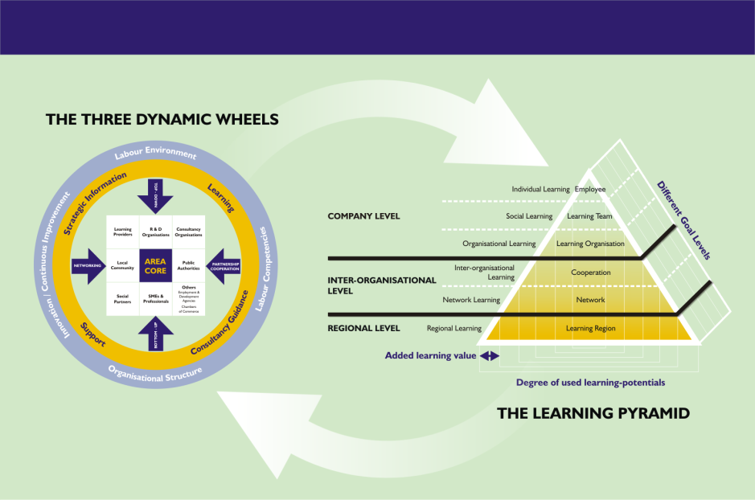

The Tourism KIC Approach has
Three Key Principles
STRUCTURE – develop a multi-stakeholder core from the business, administrative and academic/NGO communities
PROCESS – implement enterprise knowledge transfer processes based on ICT Life Long Learning for individuals, companies and regions
FOCUS - use the learning process to improve SME and work-force innovation, sustainability and competitiveness
Bringing in the Theoretical Foundation
A. Structure
A multi-stakeholder approach
B. Process
ICT- based knowledge transfer
C. Focus
Improving SME and labour force innovation, sustainability and competitiveness

Slide 13
Tourism KICs improve governance of learning processes to develop Human Potential …
Tourism Knowledge & Innovation Communities have a focus on stakeholder learning, with the aim of improving regional sustainability and SME company competitiveness to meet the challenges of and take opportunities in the global economy.
A Tourism Knowledge & Innovation Community provides a means of developing coherent policy-making and effective implementation strategies on education, regional development & business support to govern and deliver access to knowledge, education and training to tourism stakeholders.
Bringing in the Theoretical Foundation
Knowledge transfer in a Tourism Knowledge & Innovation Community should be coherently structured to reach individual workers, teams, companies and organisations, associations, and regions.

Slide 14
Tourism KICs put workforce individuals, companies and regions in a structured Flow of Knowledge …
Bringing in the Theoretical Foundation
This flow of knowledge should be structured to generate life-long learning experiences. The Learning pyramid above shows how to structure and target learning experiences effectively, linked to the concept of a multi-stakeholder knowledge transfer process focused on entrepreneurial competitiveness. Horizontal and vertical working administrative links between key learning providers need to be mapped to generate information and access relevant to:
Education & Training Institutes
Local/regional/national Administrative Bodies
SMEs, Micro enterprises, Business associations
Workforce, Residents & Travellers

Slide 15
Opportunities for Learning in the Knowledge Economy
Learning comes in a wide range of educational & training experiences.
Learning Experiences can be formal, non-formal and informal
Levels of learning cover basic communications and social skills to advanced specialist technical and administrative skills
Learning experiences are multi-site- ie Workplace, School Street, Vehicle, Home etc
They can also use multi- channel learning media ie books, Films, Radio, Apps, etc.
What sort of learning experiences can tourism stakeholders expect to be developed in this flow of knowledge in a Tourism Knowledge & Innovation Community? They will include acquiring basic social communications skills, formal and non-formal academic qualifications, and technical skills. The Community’s learning providers will also provide greater access to informal learning and, importantly for business, access to strategic information. For SMEs the Tourism Knowledge & Innovation Community can also provide support, consultancy and guidance as learning experiences.
Learning Experience Providers meet Learning Experience Clients
One of the key propositions in a Tourism Knowledge & Innovation Community is that there is better coordination of learning experience providers. Therefore it is important to involve regionally-based formal educational institutions such as schools, colleges, universities and educational authorities, and make them aware of the learning needs of tourism stakeholders. The media are also important learning experience providers. It is also important to remember that the internet now enables such providers to exist anywhere in the world, and still deliver learning experiences to a remote locality.
The Tourism Knowledge & Innovation Community model proposes that providers of learning experiences expect the Community to better identify who are the learning experience clients, and what their learning needs might be. Once again, client needs may involve anything from formal qualifications to strategic information.

Slide 16
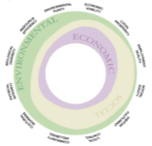
Destination and Topic
Knowledge & Innovation Communities
(Life-long) Learning Needs are best met through the application of the Tourism Knowledge & Innovation Community concept as either a Destination Knowledge & Innovation Community or a Topic Tourism Knowledge & Innovation Community, focused on tourism.
The Destination Knowledge & Innovation Community is defined geographically
The Topic Knowledge & Innovation Community is defined by subject.
Both are driven by an ICT based knowledge networking approach.
They can be implemented together, or separately, e.g. , you can have a specific coastal destination focused on setting up a nature conservation Knowledge & Innovation Community
The diagram below shows how Topic and Destination KICs both involve multi-stakeholder participation (outer blue/yellow ring) to address key challenges of sustainable tourism development (inner green ring – see next page)
Tourism Stakeholders – facing the challenges by collaborating in research to marketplace innovation processes
Tourism Topics –
defined by the economic, environmental and socio-cultural challenges & opportunities facing tourism stakeholders

Slide 17


Topic
Knowledge & Innovation Communities
A Topic Knowledge & Innovation Community brings relevant stakeholders together to facilitate knowledge exchanges on specific subjects, e.g. a Climate Change Knowledge & Innovation Community or a Sustainable Transport Knowledge & Innovation Community. A Topic Information Framework and Subject Index has been defined to organise Tourism Knowledge & Innovation Communities.
Sustainable Consumption and Production
And Tourism
Climate Change, Energy Resource Efficiency
Governance, Destination Management
Natural and Cultural Heritage
Supply Chain Management
Sustainable Travel and Transport
Quality Assessment
Certification, Marketing
Knowledge Networking Training and Education
These topics have Agenda 21 at their core, and are guided by a set of tourism sustainability principles (see Sustainable Tourism – A Guide for Policy Makers – UNEP/UNWTO 2006). They give tourism stakeholders awareness of economic, environmental, socio-cultural and institutional opportunities and challenges that need to be addressed in policy, in the market place, in training and education, and in destinations.buiness.

Slide 18

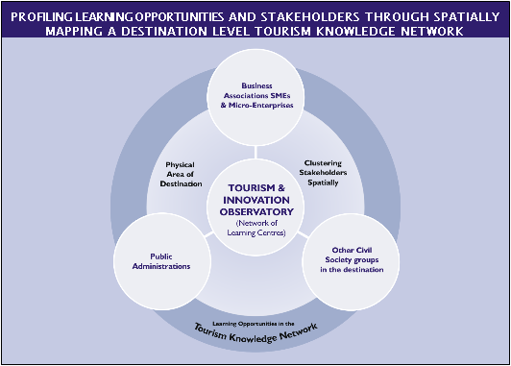

Destination
Knowledge & Innovation Communities
The Destination Tourism Knowledge & Innovation Community is a territorial unit that suits the organisation of learning experiences for a geographically specified group of administrators, SMEs, individual workers. The Tourism Knowledge & Innovation Communities approach emphasises the importance of the regional and destination-level of stakeholder interaction, as clustering of stakeholders at these levels promotes greater cross-fertilization of information.
ICT Knowledge Networking Portal

Slide 19

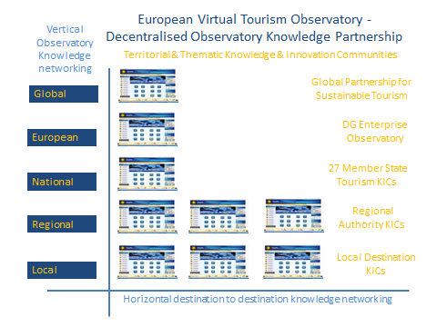
Linking Destination and Topic
Knowledge & Innovation Communities
The Tourism Knowledge & Innovation Communities approach follows the Learning Area methodology of encouraging the development of a decentralized, networked European-wide process of tourism animation and observation, rather than attempt to develop a single European – level network (which would not serve information needs at lower administrative levels). The key is to link regional innovation processes to European-wide observation systems.
The flow of knowledge from the centre of Europe to peripheral regions and vice versa can be accomplished by establishing a mosaic of destination and topic learning areas around Europe. Areas which take this step are more likely to benefit from European-level activities. This decentralised approach to linking European tourism stakeholders is made possible by modern ICT capacity, and is even becoming a necessity in order to avoid the development of large and costly administrative structures, whilst maximizing use of Europe’s growing internet capacity.

Slide 20

Key Messages
The The Tourism Knowledge & Innovation Communities approach focuses on using ICT to network tourism stakeholders in a structured way.
Tourism Knowledge & Innovation Communities are designed to link learning and observation to innovation by putting administrators, businesses and the work force in the flow of market relevant information.
They allow stakeholders to move ‘From Knowledge to Product, From Research to Market place.’ by improving links between learning experience providers and their clients.
The are based on collaborative (multi-stakeholder) use of common ICT platforms.
A common ICT portal coordinates access to learning opportunities to improve administrative coherence, work-force training, SME competitiveness and regional sustainability.
The multi-stakeholder system is directed to improving learning opportunities to develop human resource potential.
The The Tourism Knowledge & Innovation Communities model proposes that learning experience providers and learning experience clients are better identified and signposted to clearly show a region’s learning offer and what the area’s stakeholder learning needs might be.
You can have Destination Knowledge & Innovation Communities or Topic Knowledge & Innovation Communities, (ie territorial or thematic clustering of stakeholders), which can be linked to each other for maximum effect.
The Tourism Knowledge & Innovation Communities coordinators ensure improved access to formal, non-formal and informal learning opportunities.
They are necessary because a complex and competitive global economy requires greater collaboration between workforce individuals, companies and regions to establish sustainable supply chains at the destination level.
A Tourism KIC delivers knowledge for
innovation, competitiveness, inclusiveness and sustainability
by using the European knowledge economy ICT potential .
… its what you know, who you know, and when you know it!

Slide 21
PART I
Section 2
A Model Development Process
Modelling the Tourism Knowledge & Innovation Communities
Development Process

Slide 22

The Modelling Process: – a step by step system and tools to understand how to set up your own Tourism Knowledge & Innovation Community
The model takes the above theory and maps the process of setting up a Destination KIC. You will see five stages in the process:
Initiation
Coordination
Networking
Knowledge base development
Market access
Once the process has started, these stages will run in parallel, driven by the development of a common destination knowledge base. The same steps can be followed to establish a topic learning area, but the organisational structure will be different as subject-driven learning areas may not have the geographical proximity which determines the way destination learning areas organise themselves.
You will also see that the DestiNet Portal itself has been developed as an online toolkit to model your own virtual Tourism KICs following these stages, containing all the tools necessary to do the job professionally. This Guide pulls all the tools together , and can be used to locate each tool on the portal by clicking on the icons.

Slide 23

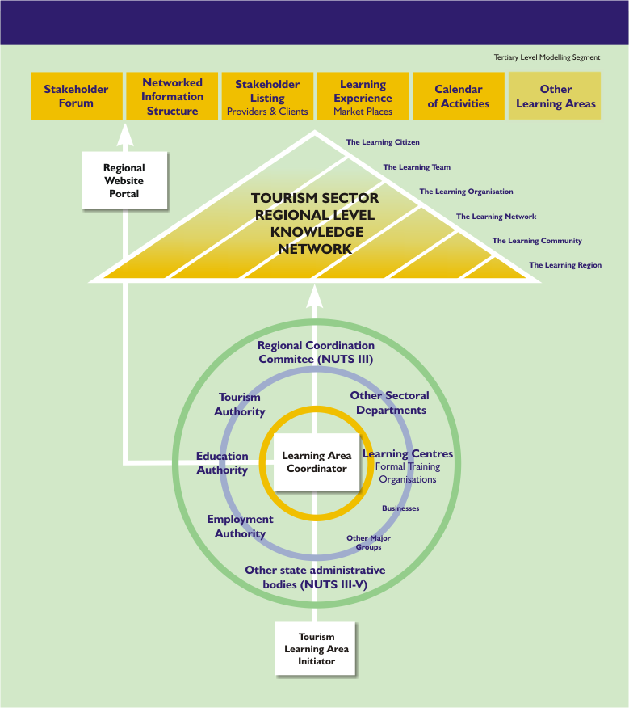
Overview of the Tourism KIC
Development Process
Five Steps to Successful Destination and Micro/SME Innovation & Sustainability through Structured Knowledge Networking
European/Global Green Economy
5. Market Access
TOURISM LEARNING AREA – REGIONAL / DESTINATION KNOWLEDGE NETWORK
4. On-line Knowledge Base Exchange
3. Multi-stakeholder Network
2. Collaboration Group
Tourism
KIC
Manager
Destination
Learning & Innovation Development Model
Tourism
KIC
Initiator
1. Initiator
23

Slide 24
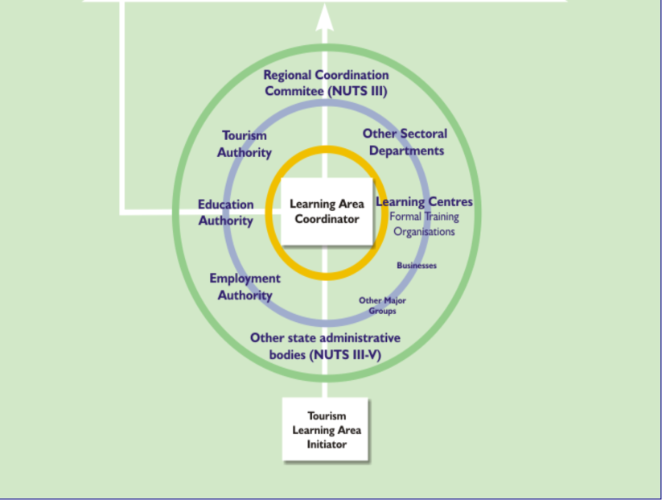
Breaking down this process … Key Steps
Step 1 – you need an initiator to get the ball rolling. The initiator raises awareness about the Tourism Knowledge & Innovation Communities approach and its ICT toolkit to potentially interested stakeholders in a given area. An initiator might call meetings, write articles, establish a preliminary website, or run workshops to stimulate interest in the Knowledge & Innovation Communities approach. Universities linked to local/regional authority enterprise agencies may be the best option to initiate a Tourism Knowledge & Innovation Community coordination group.
Step 2 – The initiator must establish a coordination group. This should be a multi-stakeholder group representing different administrative departments, businesses and NGOs, all sharing a common interest in a specific topic or process. The coordination group should identify learning needs in the area, who are the key target clients, and what range of learning opportunities are available. Note that at this stage there could be institutional rivalry to ‘own’ the Community or corner funding for the implementation. This should be countered by the development of a transparent, coherent and accountable coordination process, based on stakeholder competence. The best option for co-ordination of a Tourism Knowledge & Innovation Community is to establish a project management structure with a manager appointed from the multi-stakeholder co-ordination group.
2 Coordination Group
Tourism
KIC
Manager
1
Initiator
Tourism
KIC
Initiator

Slide 25

Step 3 – The coordination group needs to establish a multi-stakeholder network which has vertical and horizontal connections (i.e. Local to global and destination to destination). This network will be divided between learning experience providers and their clients, though in reality many individuals and organisations have both these roles, ie a business may wish to broadcast what it offers, yet needs to learn about the market in which it operates.
Step 4 – The multi-stakeholder network is connected by an online destination learning area portal. The portal has a networked structure that produces a knowledge base of relevant stakeholders, topic information, learning opportunities, news and events, and market access information.
Step 5 - In todays international internet based market place, it is important that the portal has regional to global links, and can act as a management, mapping, marketing and monitoring system. The Sustainable Tourism Knowledge & Innovation Community established in the DestiNet Portal has developed a global sustainable tourism market place for all SMEs and destinations who wish to systematically regionalise supply chains and access global opportunities.
What do they need to know?
5
Market Access
European/Global Green Economy
4
On-line Destination Knowledge Base
3
Multi-stakeholder Network

Slide 26




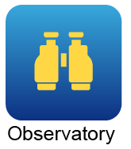
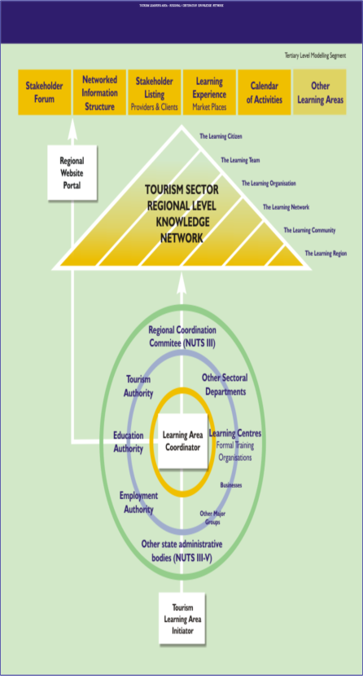



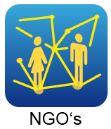

To model your own Destination or Topic Knowledge & Innovation Community a Tourism Knowledge & Innovation Community Online Toolkit has been developed for initiators and coordination bodies to follow these five steps and quickly establish online knowledge networking structures and processes.
The Tourism Knowledge
& Innovation Community Toolkit
Organising a Learing Area Knowledge Exchange in a Sustainable Tourism Communications Portal
Best Practice
Information and knowledge
These elements form the building blocks of the DestiNet Tourism Knowledge & Innovation Community Toolkit
Tourism stakeholders

Slide 27
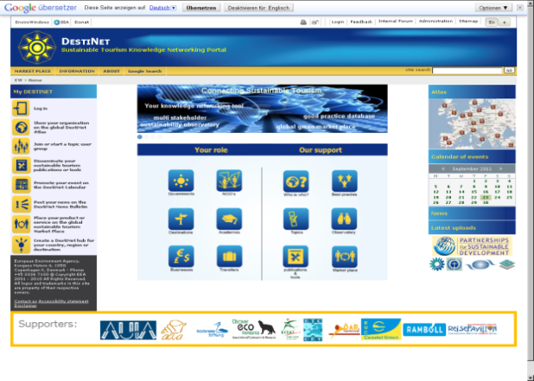
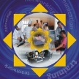
The DestiNet Portal for Sustainable & Responsible Tourism has been designed as an online tool to set up Tourism Knowledge & Innovation Communities. DestiNet is structured as a toolkit for professional use by initiators and coordination bodies to quickly establish online knowledge networking structures and processes.
The Tourism Knowledge & Innovation Community Development Toolkit on the
DestiNet Sustainable Tourism Portal
Best Practice

Slide 28
PART II – Practice
This section shows you how to build Topic and Destination Knowledge & Innovation Networks using the DestiNet Portal, which has been specifically designed to manage, map, market and monitor Tourism Knowledge & Innovation Communities.

Slide 29
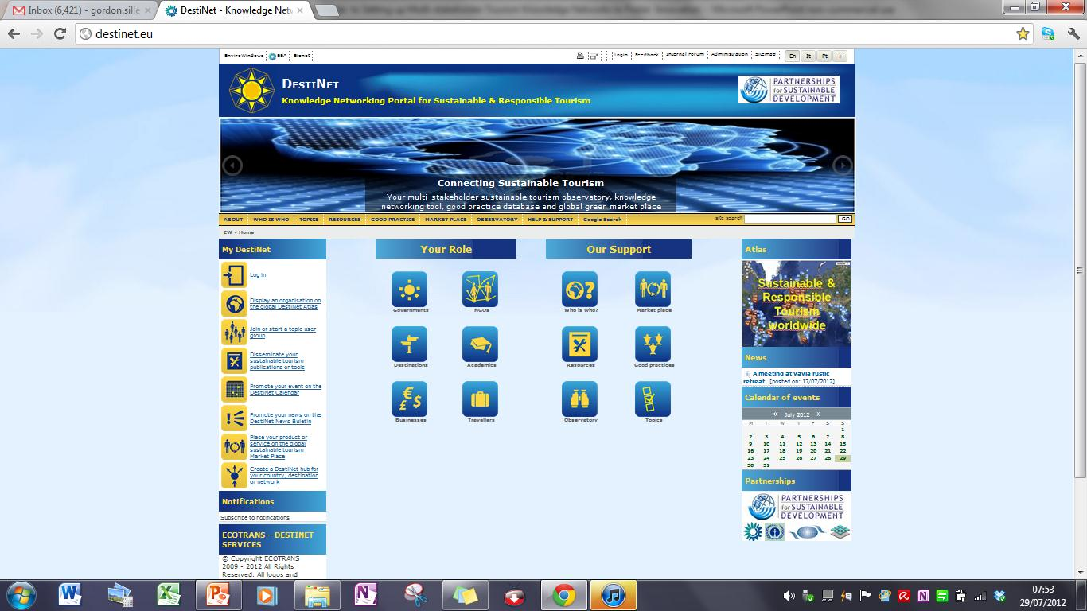
The DestiNet Tourism KIC Toolkit has been developed for professional use by initiators and coordination bodies to quickly establish online tourism knowledge networking structures and processes. This secton will take you though the basics of using the DestiNet Portal for Sustainable & Responsible Tourism as an online tool kit to set up a Knowledge & Innovation Community.
Using the Tourism Knowledge & Innovation Community Toolkit
Best Practice

Slide 30
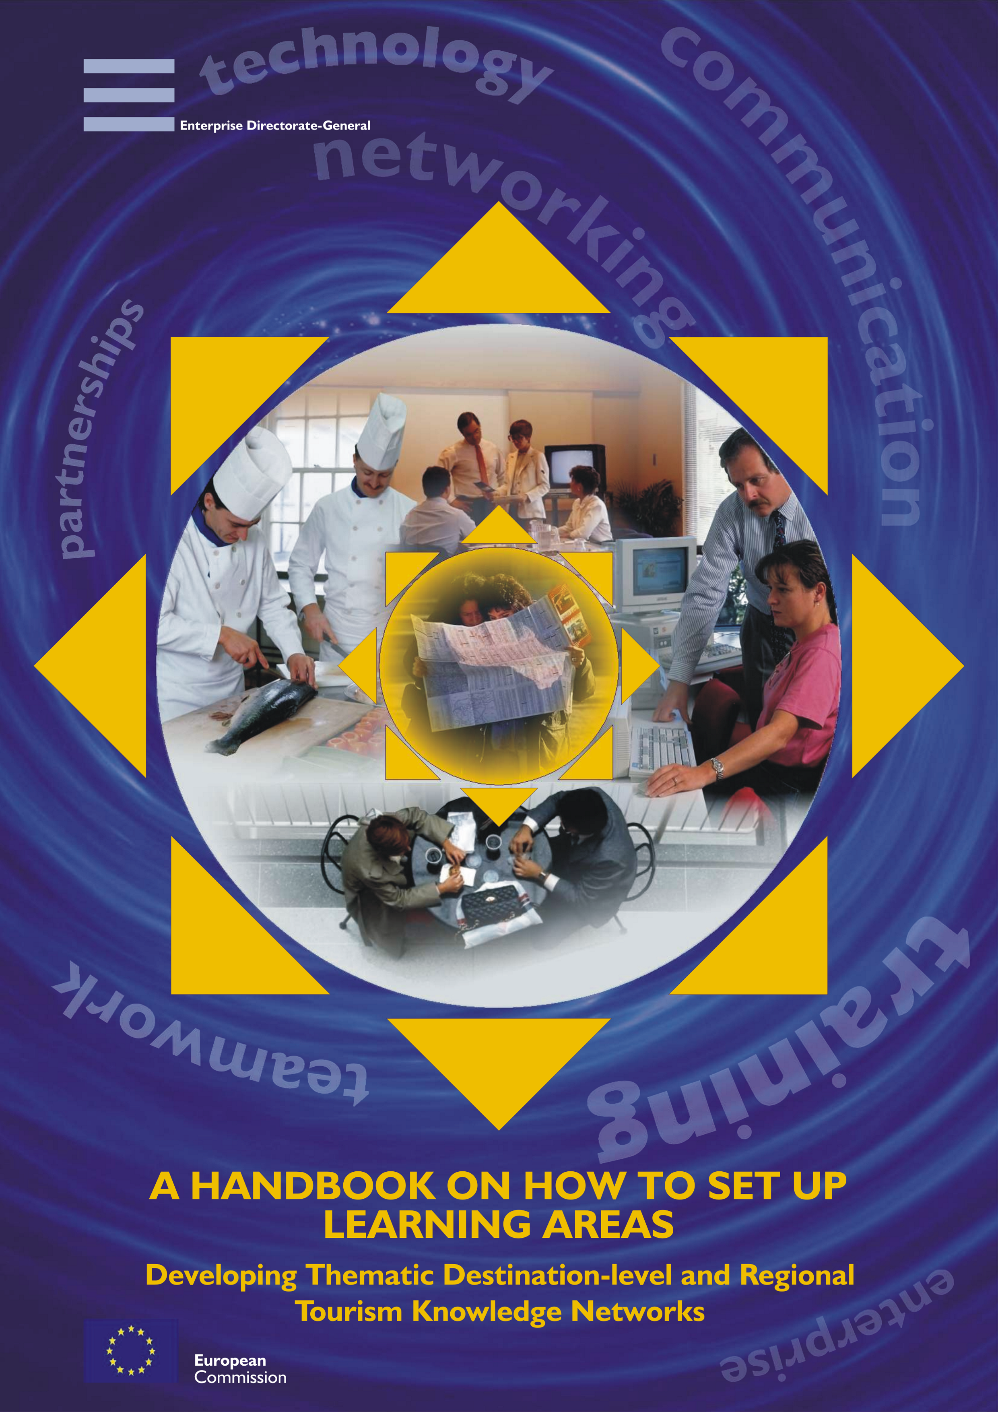
Part II Section 1 -
Setting up a
Topic Knowledge & Innovation Community
How to set up a
Topic/Thematic KIC

Slide 31
The Knowledge & Innovation Toolkit – an Overarching Topic Framework
A Topic Information Framework and Subject Index has been defined in DestiNet to organise an overarching Topic Knowledge & Innovation Community on Sustainable Consumption and Production. The topic communities connect stakeholders interested in developing their knowledge on these specific subjects in order to meet challenges or take opportunities related to each topic.
Sustainable Consumption &Production
and Tourism
Climate Change, Energy & Resource Efficiency
Good
Governance, Destination Management
Sustainable Travel and Transport
Quality Assessment,
Certification, Marketing
Natural and Cultural Heritage
Knowledge Networking, Training and Education
Supply Chain Management
This framework has general headings that can be broken down into more specialist topics, e.g. natural heritage has ecotourism and biodiversity as more specific sub-topics. The overarching subject framework of sustainable consumption and production related to tourism covers those issues that do not fit into the other general headings. Topic User Groups are listed in the folder
http://destinet.eu/who-who/civil-society-ngos/topic-user-groups.

Slide 32
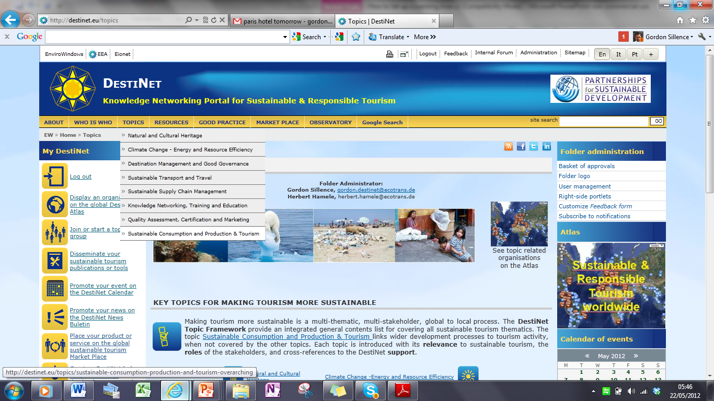
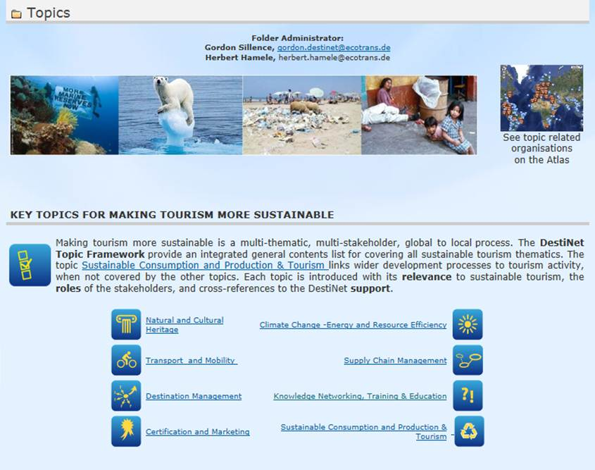
You can access quality-assessed information on any of these topics from the Portals‘ main menu bar or central portal access panel

Slide 33

Joining or Setting up a Topic KIC –
Accessing the Toolkit
To join or set up a Topic Knowledge & Innovation Community . Go online and then
Go the left hand bar and click on ‘Joining or setting up a topic group on DestiNet’, where you can follow instructions to see what groups are available, and how to set up your own group.
As DestiNet is a quality-assessed information platform, You will have to apply for folder contribution/administration rights first, then you will receive an email confirming your application.
You can then build the topic knowledge base by contributing information to the Portal using the left hand bar shown here. From this menu you and other topic learning area members can:
Profile your own organisation
Build your contact lists to establish the Topic Knowledge & Innovation coordination group and its multi-stakeholder network
List resources, publications and tools relevant to the topic
Post news and events relevant to the topic
Show sustainable tourism market place products and services
Set up a monitoring system for your topic in the Portal Observatory section
Note that Tourism Knowledge & Innovation Community members will be allocated different access rights in the portal, allowing you to either contribute information or administer your own online folder space. Please see the Contributor and Folder Administration Inductions to learn how these roles work in DestiNet.

Slide 34
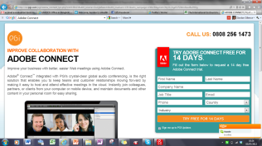
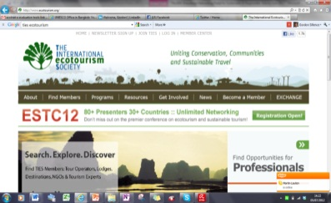
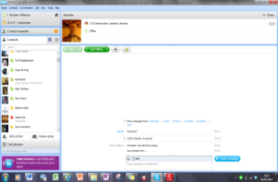
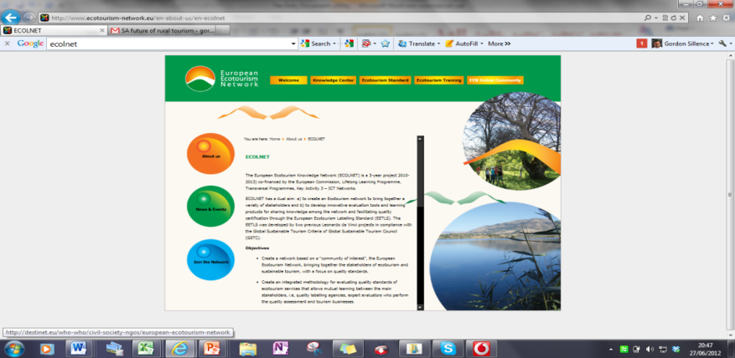
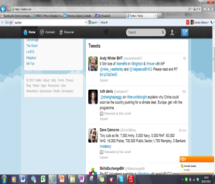
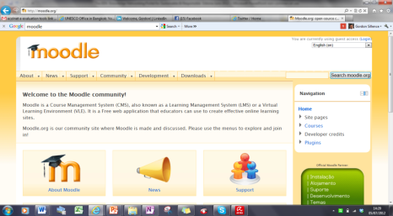
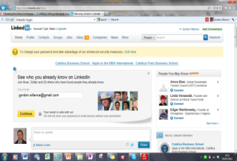
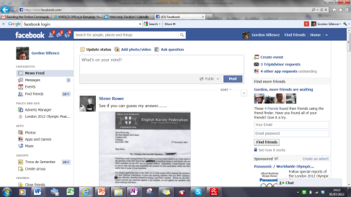
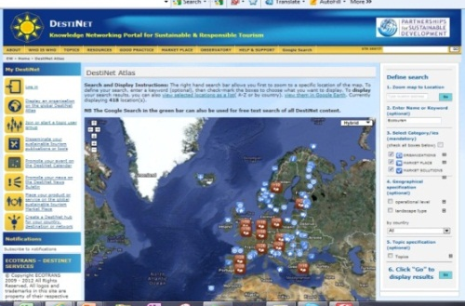
A Topic Knowledge & Innovation Community Example – The European Ecotourism
Knowledge & Innovation Community
Skype, Adobe Connect, Second Life – face-to face meeting spaces
TIES – the ecotourism practitioners online forum
EEN Website – Dedicated project website
DestiNet Ecotourism Knowledge and Innovation Community Management System linking all network elements
Moodle
European Ecotourism Labelling Standard training and evaluation tools
Linked In YouTube Facebook Twitter Flickr etc..
- Online Discussion & Image Exchange fora
Here you can see how the DestiNet Portal tools are used to as a network development & management system for ecotourism professionals, linking relevant stakeholder websites and on-line services to learn about and develop ecotourism entrepreneurial activities. The Ecotourism Knowledge & Innovation Community includes: a shared on-line project office space for the coordination body, membership mapping, an ecotourism topic management system, a multi-stakeholder, user-fed public access ecotourism knowledge base, a dynamic document on-line storage system, a market access tool, an ecotourism observatory management system, plus additional tools and resources, including the use of the Portal as a post project management tool.

Slide 35
Part II Section 2
Setting up a Destination
Knowledge & Innovation Community
Destination Tourism Knowledge & Innovation Community Toolkit

Slide 36
Setting up a Destination
Knowledge & Innovation Community
The DestiNet Portal has been designed as an on-line tool to set up a Destination Knowledge & Innovation Community .
Go the left hand bar and click on Create a DestiNet Hub, where you can follow instructions on how to set up your own destination KIC at either local regional or national level.
You will have to apply for folder administration rights, as DestiNet is a quality-assessed information platform, and you will receive an email confirming your application .
You will be given a folder under the Who’s Who menu. You will need to add relevant stakeholders and information
The key idea of the site design is to add content to the top yellow menu bar options , using the
yellow left hand menu bar to input your information.
Note that Tourism KIC members will be allocated different access rights in the portal, allowing you to either contribute information or administer your own online folder space. Please see the Contributor and Folder Administration Inductions to learn how these roles work in DestiNet.

Slide 37
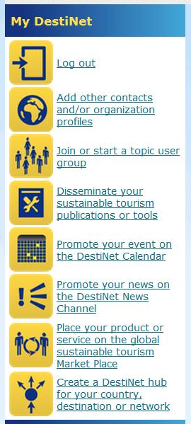
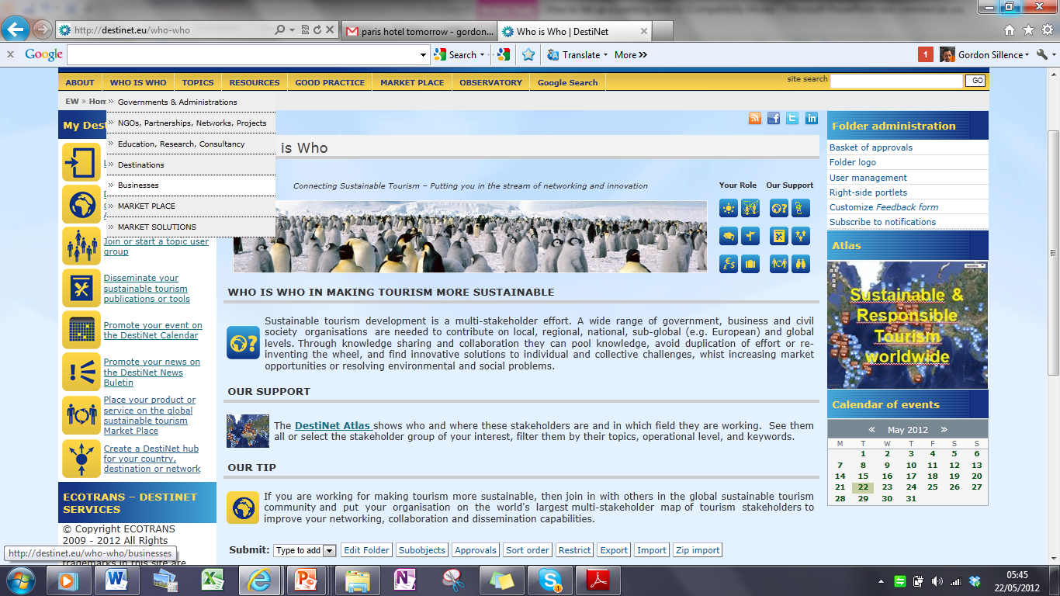
Stakeholder Mapping Tool
Add your own contacts to this section, using the left hand bar. Note that you can also profile these organsiations This tool will list and map the coordination group, useful organisations and knowledge network members in your Destination Learning Area
This list will also contain a list of learning experience providers in your destination, as well as who is interested in or who can support improvements in quality and access to learning about making tourism more competitive and sustainable.
*Note there are a folder edit or bulk upload options in the Portal where you can use Excel to prepare your information.

Slide 38

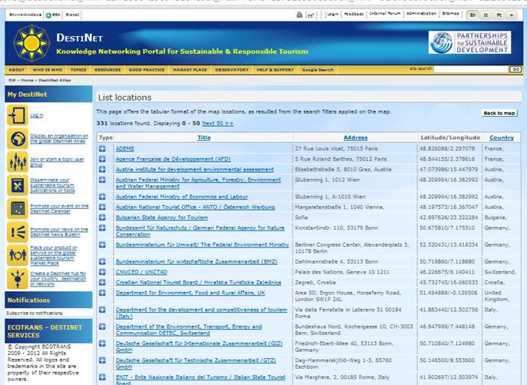
The Stakeholder Mapping Tool will produce both a map or A-Z listing of your stakeholders. You can view them via the DestiNet Atlas.

Slide 39
Sustainable Tourism
Topic Framework Tool
What topics is your Tourism Knowledge & Innovation Community interested in? Remember that a Topic Knowledge & Innovation Community may already exist, so link your Destination Knowledge & Innovation Community to that Topic Knowledge & Innovation Community .
You should prioritze and add information relevant to your destination using all the features of the left hand bar to add topic information such as publications, news, events, etc., to profile your Tourism Knowledge & Innovation Community resources and activities.

Slide 40
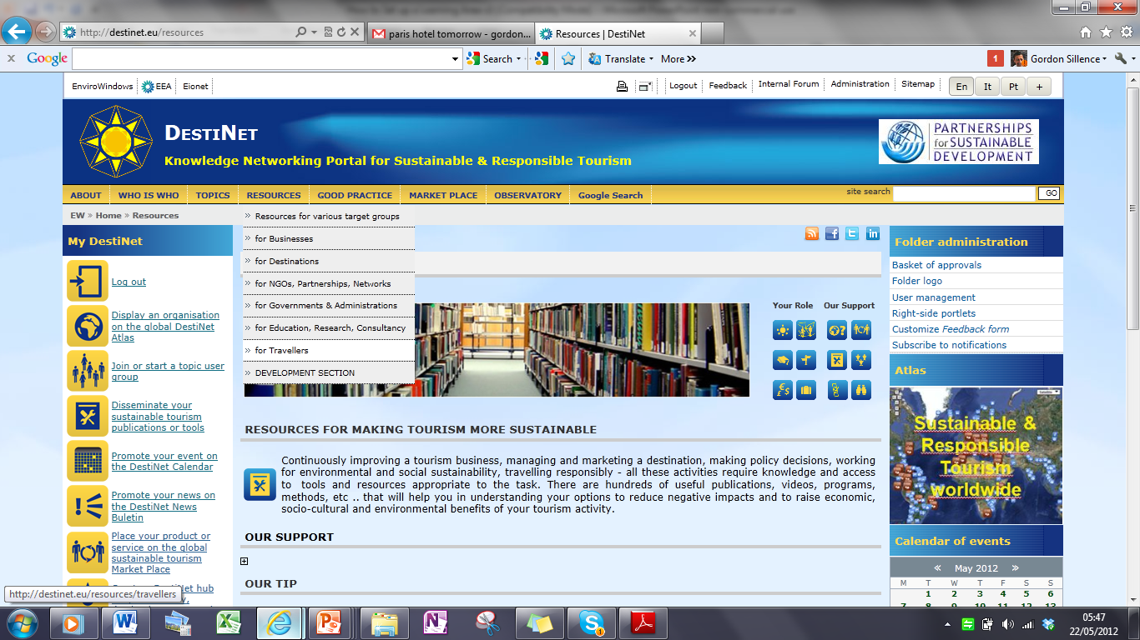
Resource Listing Tool
Your knowledge base must include access to information enabling stakeholders to contribute to and to benefit from competitive, responsible and sustainable tourism development. All publications are stored in the resources section then linked to other folders in DestiNet.

Slide 41
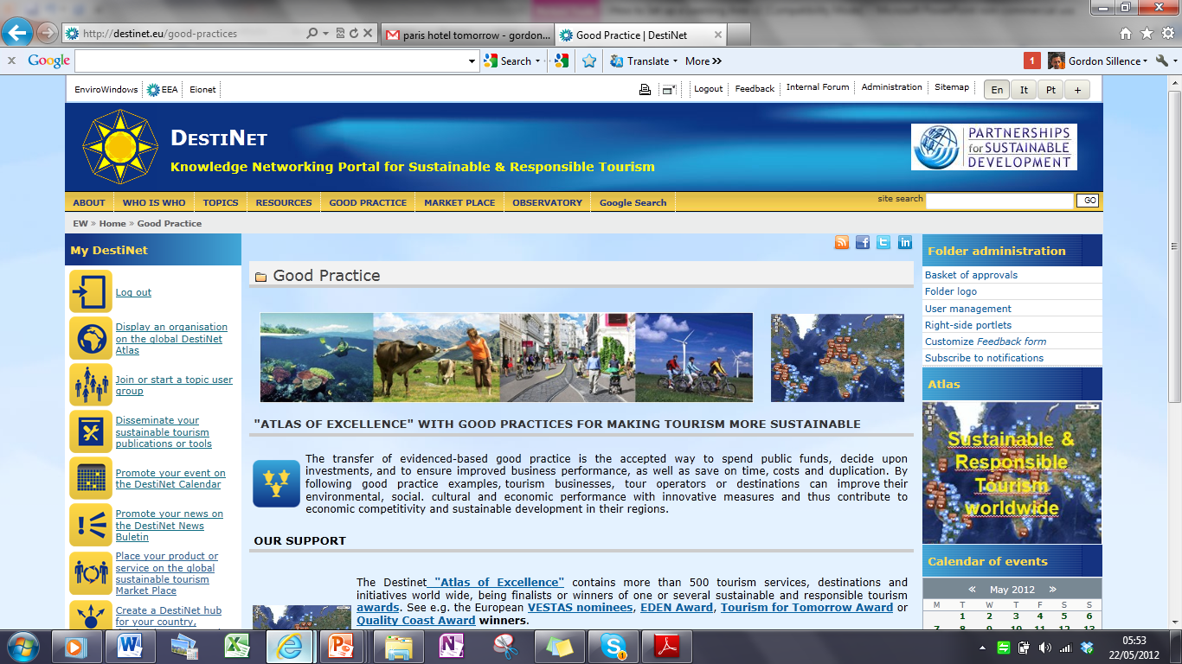
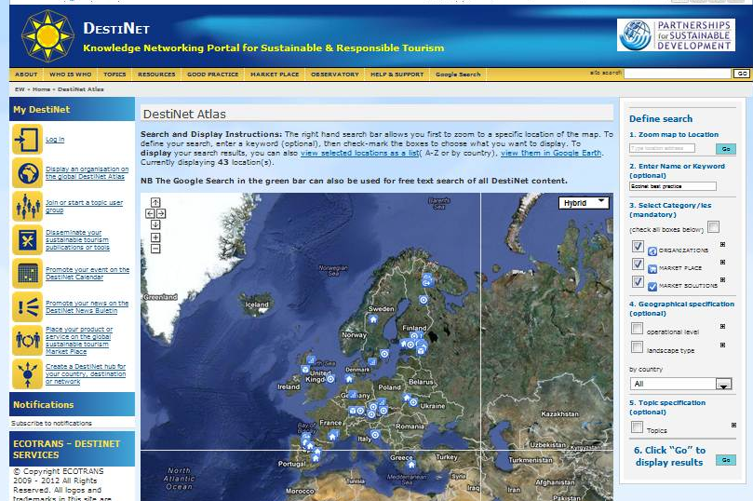
Good Practice Transfer Tool
Best Practice
The transfer of good practice between stakeholders in a Tourism Knowledge & Innovation Community is key to destination innovation, competitiveness and sustainability. The Destinet good practice transfer tool has a template that structures good practice examples and is accessed from the publication dissemination tool. Choose the good practice transfer template.
As well as profiles of good practice examples, the good gractice tool can produce maps and lists of these examples, showcasing them in DestiNets ‚Atlas of Excellence‘.

Slide 42
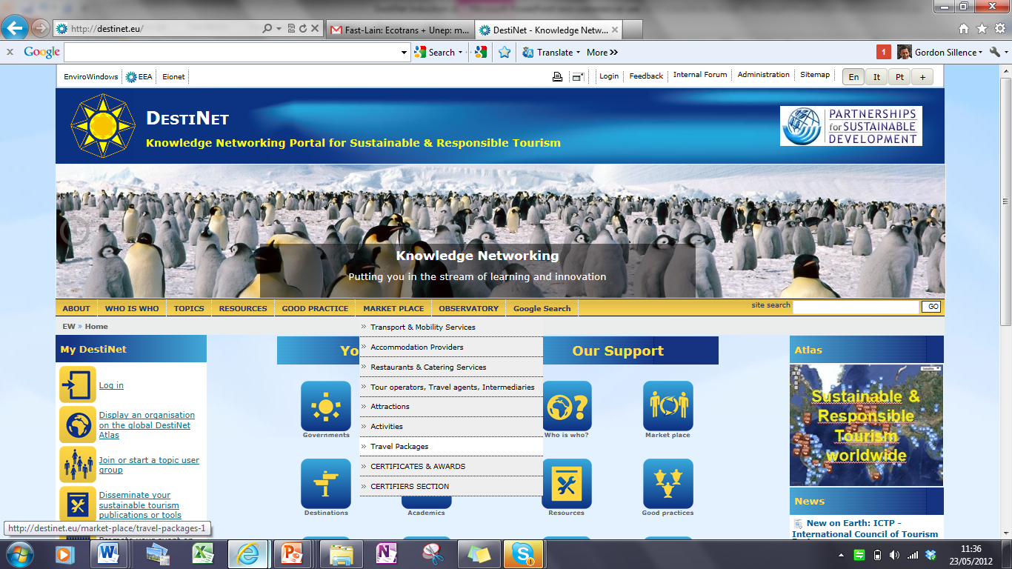
Market Access Tool
A Tourism Knowledge & Innovation Community knowledge base needs to orient itseff to the regional or global market-place. To imporve regional competitiveness, the Destination Knowledge & Innovation Community can create a virtual map of its tourism offer, showing the learning opportunities and business mosiac related to the destination.
Market-listed products and services can be used to market the destination, identify and build products and services for travel agents and tour operators, put packages together, provide information to journalists, and supply consumer facing sites with quality assessed information .
.

Slide 43
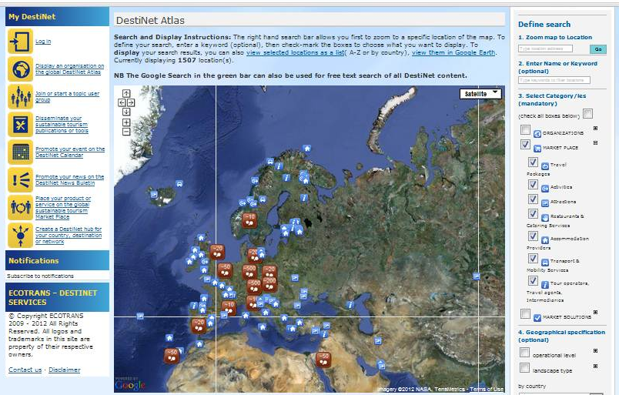
The Market Access tool on the Portal enables you to list your your tourism learning opportunities, and certified products and services. If they are certified they can enter the portals‘ sustainable tourism market place. In this respect the Market access tool offers a destination the possibility of making a Green Map of its tourism offer, and building maps of its tourism supply chains.
Again the Market Access tool provides listing and map presentations of market offers, and the Tourism Destination & Enterprise Innovation Stimulation Tool provides a structured approach to developing market access for your product or destination.
The Market Access tool has a sophisticated filter system that enables users to sort and list organisatons and products by geographical region, type of market offer (accomodation, attraction, etc) operational level, and landscape type. It also offers a market solutions section to list support services a destinaion and its businesses will need to be more competitive and sustainable. Porviders of such services can list themselves in this section.

Slide 44
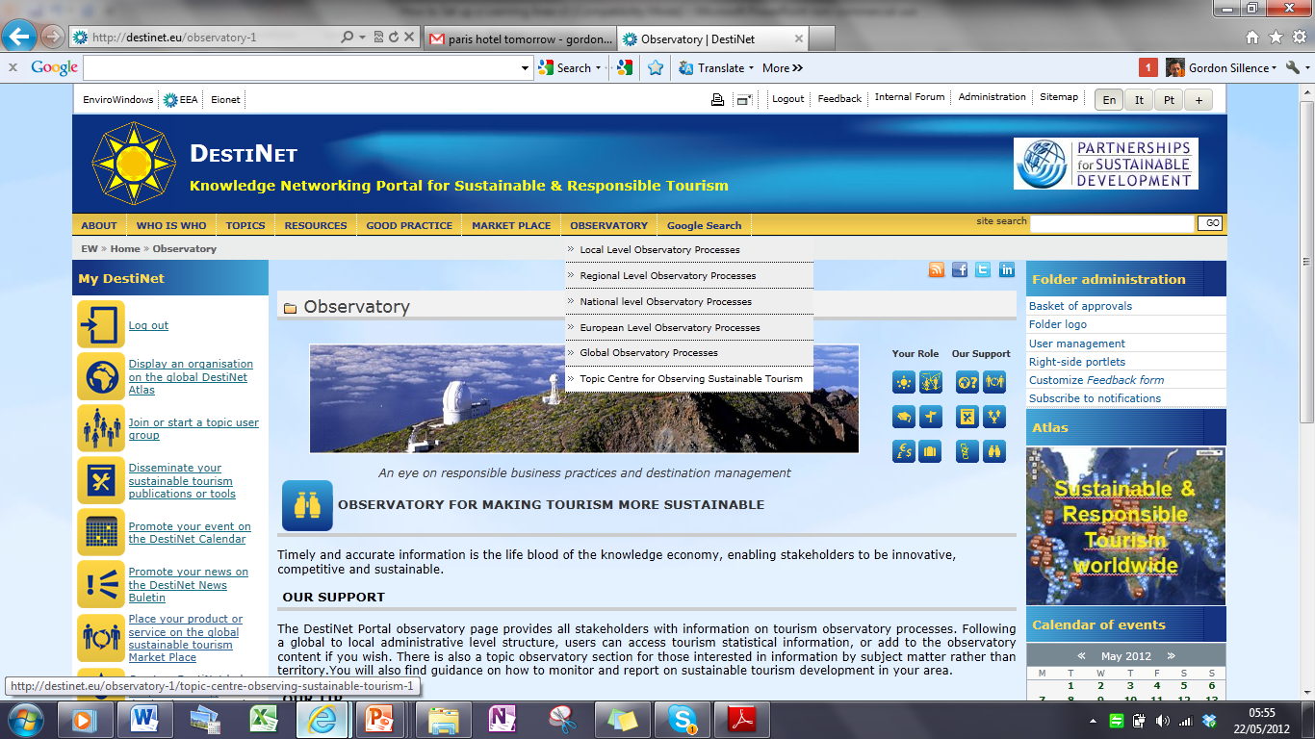
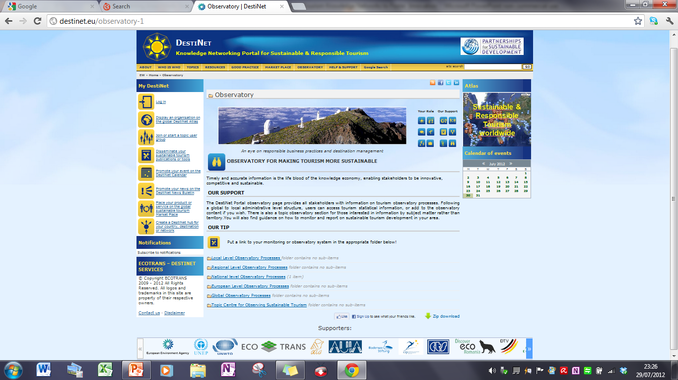
Tourism Observatory
Management Tool
Destinations need to monotor their tourism competitiveness, and stakeholders need monitoring and reporting information in a form specific to their learning needs. You can establish your Tourism Knowledge & Innovation Community monitoring system in this section, starting with gathering sources of information that are already available. The Tourism Observatory Management Tool enables member states, regions and destinations to link up their own innovation and observation processes. Based on existing sources of tourism monitoring data, and then adding their own monitoring and reporting systems. Guidence is also given via access to destination management and business susainability checklists.

Slide 45
Tourism Destination & Enterprise
Innovation Stimulation Tool
Framework to Overview, Design and Stimulate
Micro/SME & Destination Innovation Processes
The research to marketplace Innovation process is shaped in each of the following stages of business or destination development:
RESEARCH > POLICY> PRODUCT/DESTINATION DEVELOPMENT
PROMOTION > MONITORING >
This knowledge cycle leads to a set of LEARNING OUTCOMES which stakeholders can then use to develop their tourism businesses or destinations, and also fed back into the Tourism Knowledge & Innovation Community research to market innovation cycle to produce continuous improvements in stakeholder activities, in part or as a whole. The following matrix can be used to chart this process.
1 Research to Market Innovation Cycle Phase | 2 Stakeholder Actions | 3 DestiNet Knowledge & Innovation Community Support | 4 Link to Case Study/ Implementation Process/ Documents
Research | Access European knowledge base Knowledge transfer Development of evidence-based good practice | Whos Who – knowledge networking Topics – sustainable tourism subject matter Good practice database & transfer system | (use columns 2 and 3 to construct a specific example or process)
Policy | Implementation of good governance principles Policy coherence Openness Transparency Participation Accountability Effectiveness | Who’s Who - Multi-stakeholder participation Topics- SCP and tourism, Learning area policy grid Resources- Policy tools Survey tool Observatory | Worksheet or document reference (Use .pdf insert note function)

Slide 46
Development of product/ Destination | Assessment of field, similar operations and actors Resource Access | MarketPlace Atlas of Excellence Resources
 | Development of certification & quality cycle systems | Topics Resources
Promotion/ Market Access | Market access actions | Market-place News and Events Topic Fora Survey tool
Monitoring | Supply chain and destination management | Observatory Survey tool Market Profile – Atlas Sustainable destination management checklist Sustainable Business checklist Tourism KIC checklist of Knowledge & Innovation Activities
LEARNING OUTCOMES
Spatial/thematic Assessment/ Profiling | Process and performance review | Observatory
Good Practice Case Examples | Contribution to/use of Expert knowledge base to assess best practise | Atlas of excellence
Strategic Information for product/destination development | Contribution to/use of Expert knowledge base to develop product and improve market access | Whos Who Topics Resoruces Market-Place News, events
Key Lessons | Contribution to/use of Expert knowledge base | Ask Expert service Topics Information workflow contributor/Administrator
To use this tool, go to DestiNet and downoad the .pdf Template

Slide 47

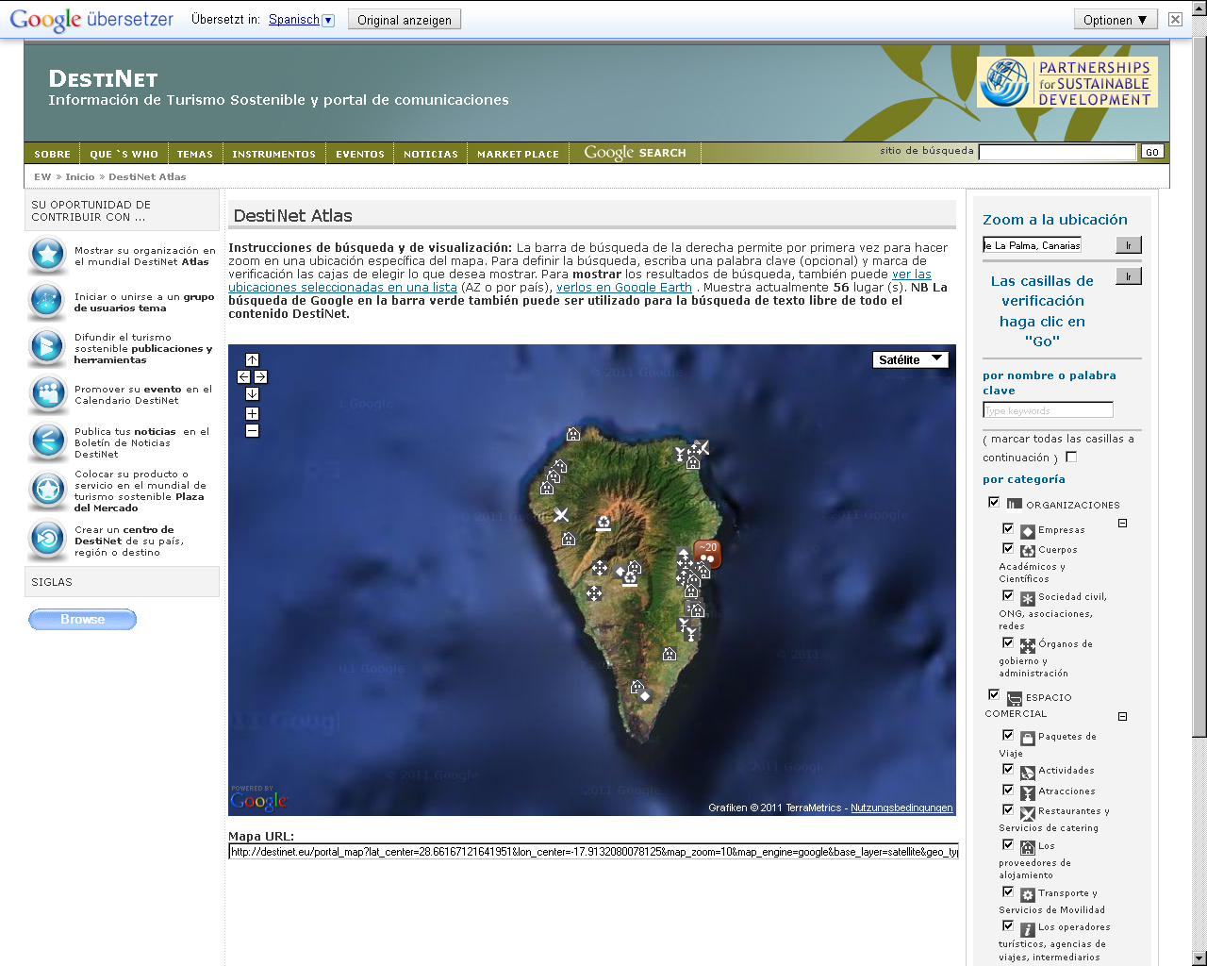
A Destination Knowledge & Innovation Community Example –
La Palma Biosphere Reserve
The DestiNet Toolkit has been developed in the FAST-LAIN project to meet the needs of destination administrators who wish to develop knowledge network-driven innovation processes to improve their tourism offer. Here you can see how the Biosfera de la Palma (Spain) has used the Portal to set up a knolwdge & Innovation Community.
The Biosfera de la Palma has used DestiNet to create a virtual Knowledge & Innovation Network on La Palma. Using the Tourism Knowledge & Innovation Community toolkit it has been able to:
Assess its own competitve and sustainable tourism situation
Manage its own space on the portal for mapping stakeholders
Is developing an innovation cluster called the ‚La Palma Club‘ to set up a learning area on sustainable tourism development for members
Define a green map of Biosfera La Palma sustainable tourism offers on the Portals‘ global sustainable tourism market place
Develop International knowledge networking links
Contribute to the virtual European Tourism Observatory concept
The La Palma
Destination Learning Area Cluster

Slide 48
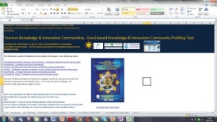
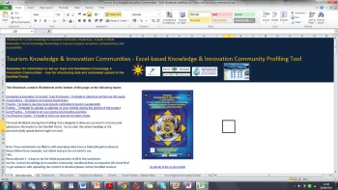
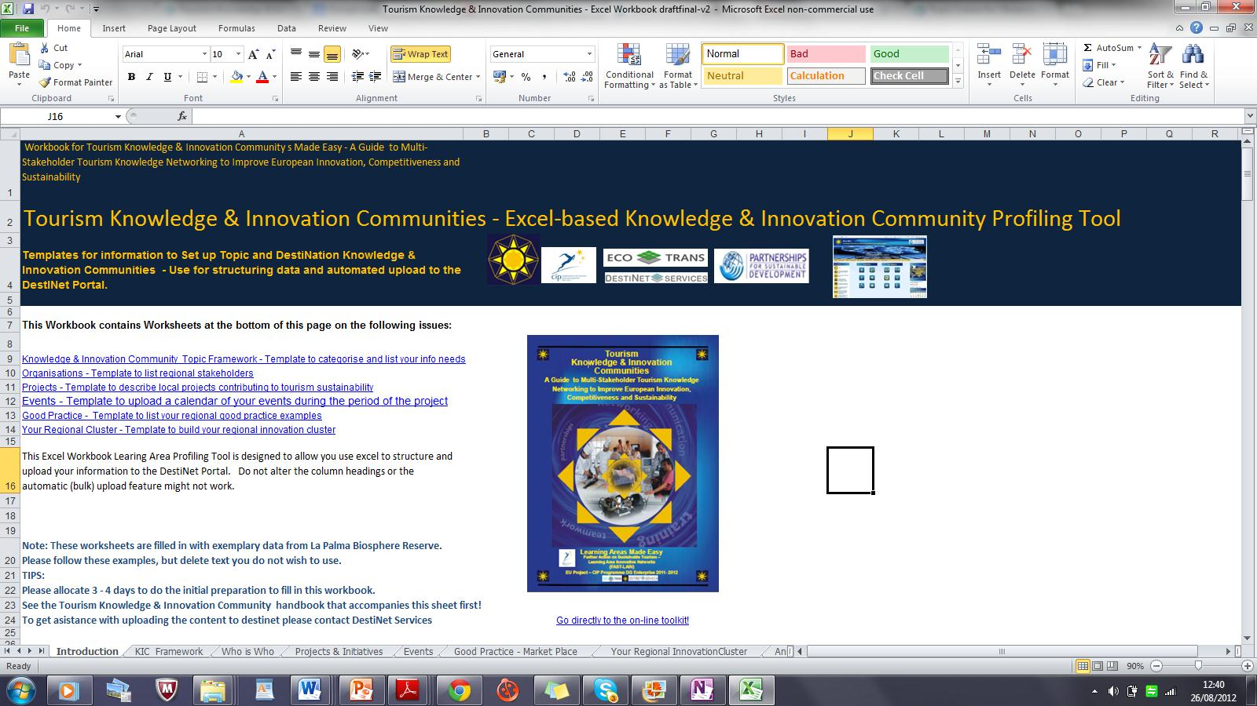
Off-line System Use
Please note that if you want to use an offline way to set up your learning area , then you can download an Excel workbook from the Tourism Knowledge & Innovation Community Resources section. This workbook follows the DestiNet Portal structure, so that you can either bulk upload to the online system yourself or use the DestiNet uploading service
Access the offline Workbook

Slide 49
PART III
Next Steps
Costs of Setting up a Tourism Knowledge & Innovation Community
  Next Steps
Check List to Set Up a Tourism Knowledge & Innovation Community
  Next Steps

Slide 50
Key Question –
the Cost of Setting Up a
Tourism Knowledge & Innovation Community
Just as no-one can tell you the cost of the proverbial length of string, the cost of setting up a Tourism Knowledge & Innovation Community depends very much on:
who does what
at what scale
how much collaboration is involved
what outcomes are envisioned by the coordination team
Start up costs could vary from 0 - 1000 € or more →. However, if the objective is to revamp the entire learning offer of a destination in a five year plan including new infrastructure, new jobs, greater educational capacity, increased marketing etc then the cost could be millions.
Originally the learning area concept was conceived as a zero cost exercise that required only a change in working culture, moving from the current disconnected governance models to more coherent multi-stakeholder integrated planning. Experience has shown that this is not possible, and that there is a necessary resource commitment, especially staff time, to make such a change. The reality will alter from destination to destination, or topic to topic, and each Tourism Knowledge & Innovation Community will have to perform within its own budgetary possibilities.
IMPORTANT: A very practical part of this toolkit is that you can use the Tourism Knowledge & Innovation Community workbook to define the activities you would like to carry out as a cluster. You can then develop a business plan to cost the activities you identify in the work book that are relevant to your activities. In this way you can plan the cost of your Knowledge & Innovation Community development or management work.

Slide 51
.
In Conclusion: Your Next Steps
to Set Up a
Tourism Knowledge & Innovation Community
Prepare your understanding, reason and presentation of the Tourism Knowledge & Innovation Community concept that suits your needs Use the DestiNet Tourism Knowledge & Innovation Community Developers Toolkit to do this.
From the administrative and business stakeholders Find the right partners -or a champion - with the right competences to establish the coordination group.
Agree on a vision statement on challenges, opportunities, potential areas of cooperation and realistic costs using the excel workbook to define activities for your business plan
Agree or sign-up to a formal or informal collaboration agreement
Develop your virtual Tourism Knowledge & Innovation Community using the online tools
Develop promotional processes as time-bound projects with selected members to improve SME and workforce learning opportunities
Establish a Time Frame for your Tourism Knowledge & Innovation Community, using the Calendar of Events function.
Build in a monitoring and reporting system for your Tourism Knowledge & Innovation Community to measure progress, using the process and performance indicator approach described in the Virtual Tourism tory design report section.
This Guide contains all the tools to do the above steps.
This Handbook is available in the Portal in the Tourism Knowledge & Innovation Community section under Networking, Education and Training, and is also listed in the resources section. For further information use the portal to find our more about destination and topic learning areas.
You will also be able to find the original technical manual, which will provide a very detailed set of procedures, checklists and applications of the Tourism Knowledge & Innovation Community concept.

Slide 52
.
Checklist for Establishing a Tourism Knowledge & Information Community
Initiator
Task:
Prepare initial concept presentation
Hold event to establish a multi-stakeholder coordination group
Tools: networking topic, stakeholder listing, resources, events
2. Coordination Group
Task:
Identify learning needs in the area
Identify who are the key target clients
Identify what range of learning opportunities are available
Establish a project management structure
Appoint manager from the multi-stakeholder co-ordination group.
Develop collaboration agreements to establish your KIC
Tools: networking topic, stakeholder listing, resources, events, market-place
3. Multi-stakeholder Network
Task: establish a multi-stakeholder ICT Community
Vertical connections
Horizontal connections
Listings of learning experience providers and clients
Inventory of human and financial resources
Tools: networking topic, stakeholder listing, resources, events, market-place
4. On-line Knowledge Base Exchange
Task: set up a knowledge base of :
relevant stakeholders
topic information
learning opportunities
news and events
market access information
Tools: networking topic, stakeholder listing, resources, good practise transfer system, news & events, market-place, observatory, contributor rights, folder administration
5 Market Access
Task: make sure your portal has:
Regional to global links
Destination supply chain management system
Destination and product mapping system
SME marketing system
Destination monitoring & reporting system.
An SME innovation programme
Tools: marketing & certification topic, stakeholder listing, resources, news & events, market-place, survey observatory, innovation stimulation tool, contributor rights, folder administration

Slide 53
.
A final word to those who want to use the DestiNet Tourism Knowledge & Innovation Community on-line development and management tools ...
See the Induction to DestiNet
My DestiNET
Build up your own profile and add your own information
Find out how to manage a folder space on DestiNet order to set up and administer your networks, run projects, manage your destination, green your company, etc…
Set up RSS links to your organisations website to automate news and events flows.

Slide 54






Further Information
Thanks to the European Commission DG Enterprise for administrative and financial support , and to all FAST-LAIN Project Partners, Experts and Supporters who participated in the project:
PARTNERS Antonio San Blas, Isabel Gonzales Rodriguez | Consorzio Insular de la Reserva Mundial de la Biosfera La Palma
Peter Prokosch, Christina Cavaliere | UNEP/GRID-Arendal
Maria Gravari-Barbas | IREST - Université Paris I Panthéon-Sorbonne
Blanka Belosevic | Croatian Ministry of Tourism
Mikael Backman | Lunds Universitet - IIIEE
Teresa Müller | Tourismus Zentrale Saarland
Adao Flores EXPERT GROUP | Universidade do Algarve
Herbert Hamel Gordon Sillence Richard Denman | Ecotrans FAST-LAIN Project director Ecottrans FAST-LAIN Project director The Tourism Company
Marion Hammerl | Bodensee Stiftung
Francesca Conti | ACTA
Ghislain Dubois | TEC
Karl Reiner | ÖAR
Naut Kusters, Hugo de Jong | ECEAT Netherlands
Vasilis Tsipidis | Prisma/EEN
Peter Zimmer SUPPORTERS | Futour
Helena Rey, Deirdre Shurland | United Nations Environment Programme
Luigi Cabrini | UN World Tourism Organisation
David Stanners, Paolo Meozzi | European Environment Agency
Fernando Santander | European Travel Commission
Dirk Dunkelberg | German Tourism Association
Lorenzo Canova DG Enterprise Tourism Unit | Italian Ministry for Economic Development European Commission
Software & Graphics by EU de Web, Desktop Display and Andreas Muller
Diagrams in this presentation have been reproduced from ‘Innovation in Tourism – how to create a tourism learning area’ European Commission 2006
To set up or manage a Tourism Knowledge & Innovation Community please contact
Ecotrans – DestiNet Training, Education & Development Services www.destinet.eu
Herbert Hamele herbert.hamele@ecotrans.de
Gordon Sillence gordon.destinet@ecotrans.de

